Slide 1
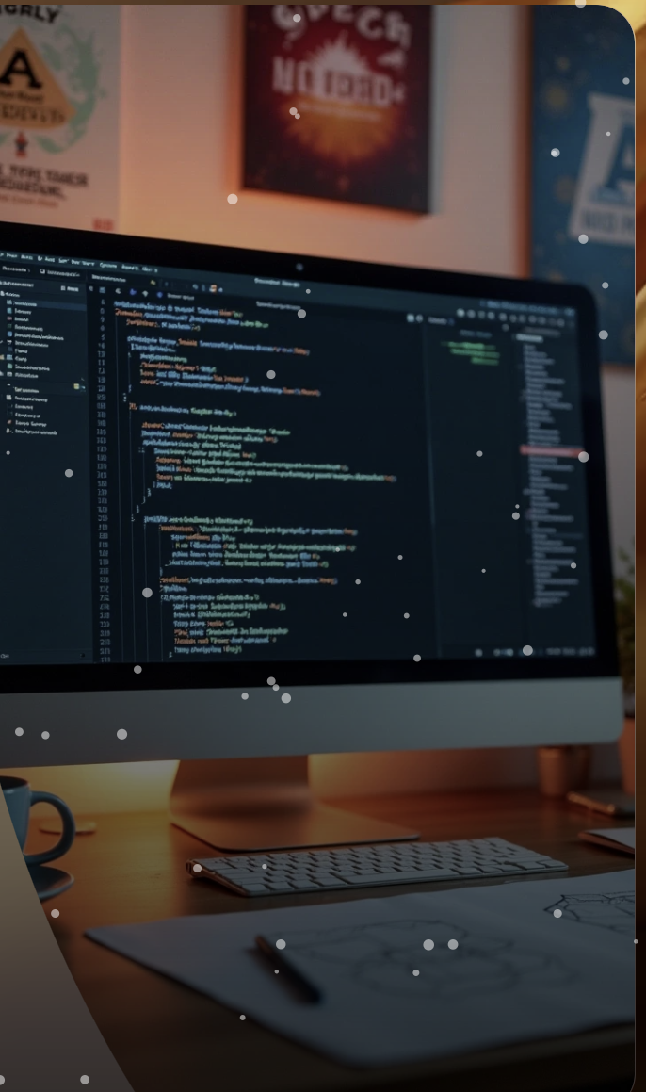
Y Purna Chandra Reddy – 2300033083
K Abhitej Reddy - 2300033191
Granite Open-Source Models
Granite Open-Source Models represent a new wave in machine learning and AI, emphasizing collaboration, transparency, and community-driven enhancements while offering versatile solutions for various applications.

Slide 2
Overview of Granite
Definition and Purpose: Granite refers to a set of open-source models in AI that are designed to be flexible, accessible, and beneficial for developers and researchers alike.
Key Features: The models are characterized by easy integration, well-documented code, and active community engagement that fosters knowledge sharing and improvement.
Use Cases: Professionals can utilize Granite models for tasks such as natural language processing, computer vision, and predictive analytics, making them ideal for diverse industries.

Slide 3
Architecture and Flow Chart
Model Architecture: The Granite models utilize neural networks and deep learning technologies, providing a robust framework for training and inference.
Flow Chart Explanation: A flow chart illustrates the process from model training to deployment, including data preprocessing, model evaluation, and performance optimization.
Components: Essential components include data inputs, neural network layers, activation functions, and output layers, all of which contribute to the model’s overall performance.

Slide 4
Installation and Setup
System Requirements: Users need a compatible operating system, necessary libraries, and dependencies required for running Granite models efficiently.
Installation Steps: A detailed guide outlines how to clone the repository, install required packages, and configure the environment for optimal performance.
Testing the Installation: After setup, users should run sample scripts to verify that everything is functioning correctly, ensuring a smooth start to using the models.

Slide 5
Training and Fine-tuning
Training Process: The training involves feeding large datasets into the models and adjusting weights through backpropagation, allowing the model to learn patterns in data.
Hyperparameter Tuning: Users can fine-tune hyperparameters like learning rate and batch size to enhance model accuracy and performance based on specific tasks.
Cross-Validation Techniques: Implementing cross-validation helps in assessing the model's generalizability and reduces the risk of overfitting, leading to more reliable outcomes.

Slide 6
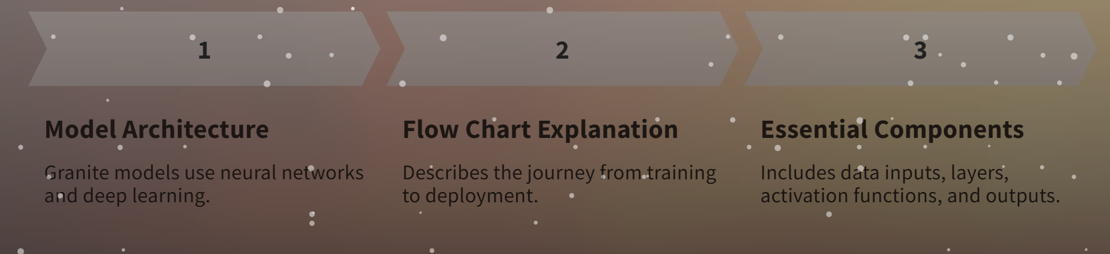
Community and Contributions
Open-Source Community: Granite thrives on community contributions, encouraging developers to submit improvements, bug fixes, and new model implementations via platforms like GitHub.
Documentation and Tutorials: Comprehensive documentation and tutorials are provided to assist new users in understanding the models and making effective use of them.
Collaboration Opportunities: Users are encouraged to collaborate with others in the community on projects, fostering innovation and the exchange of ideas.

Slide 7
Real-World Applications
Industry Implementations: Various organizations have successfully adopted Granite models for real-world applications, including healthcare diagnostics, e-commerce recommendations, and automated content generation.
Case Studies: Detailed case studies showcase how these models have improved efficiency, reduced costs, and enhanced decision-making processes across different sectors.
Future Outlook: The growing interest in open-source solutions in AI signifies a promising future for Granite models, with potential expansions into various new fields.

Slide 8
Conclusion and Future Directions
Summarization: Granite Open-Source Models represent a significant shift towards collaborative development in AI, with their flexibility catering to a range of applications and industries.
Future Development: Ongoing enhancements and model updates are anticipated, driven by community feedback and technological advancements, ensuring Granite remains at the forefront of open-source AI.
Engagement Invitation: The Granite community welcomes new users, contributors, and companies to explore, integrate, and build upon their models to drive innovation and research forward.

